Slide 1
Cyprus 2017: An Overview
P.G.Economides & Co Ltd
Chartered Certified Accountants
www.pgeconomides.eu
Andry Panteli, FCCA
Director
andry.panteli@pgeconomides.eu
CH International
Dubai, U.A.E
26 Oct 2017

Slide 2
Cyprus 2017: Overview
Cyprus at the Forefront of
International Developments
Notes:
1

Slide 3
Cyprus economy brief & actions
Cyprus economy is no longer in recession and as from 2015 has marked growth
Successful issues of Government Bonds to the international markets
Economy and banks upgraded by international credit rating agencies
Cyprus remains at the forefront of developments
Government adopts measures enabling Cyprus to remain fully compliant
… AND at the same time to retain its competitive advantages as an attractive International Business Center.
This is achieved through continuous legislative updates and other incentives so that Cyprus remains attractive to foreign investors who perform their international activities in, from or through Cyprus

Slide 4
Cyprus specific actions
Compliance:
Fully compliant with US FATCA (‘IGA Model I’)
Signed the Convention for Mutual Administrative Assistance in Tax Matters / ‘Early Adopter’
(along with other 90+ countries)
AML /ATF related laws and controls in place
New and revised tax treaties based on the updated OECD Model Tax Treaty
Full regulation of service and trust providers (including auditors and lawyers)
Incentives:
Modernisation of the Cyprus International Trusts Law
Relaxed and more attractive conditions for the Cyprus Citizenship and Permanent Residency Permit
New tax law amendments for companies and for foreign individuals who decide to move and live / work on the island
New attractive corporate tax provisions

Slide 5
Needed elements for the use of any foreign jurisdiction
Compliant jurisdiction
Attractive TAX regime
Establishing physical business SUBSTANCE
Workable Corporate and Legal frameworks
Moving key personnel
Good DTT network and access to EU Directives
Moving executives and their families
Ability to address topical issues like CFC, GAAR,
Substance and Beneficial Ownership of income

Slide 6
Needed elements for the use of any foreign jurisdiction
Compliant jurisdiction
Attractive TAX regime
Establishing physical business SUBSTANCE
Workable Corporate and Legal frameworks
Moving key personnel
Good DTT network and access to EU Directives
Cyprus
Moving executives and their families
Ability to address topical issues like CFC, GAAR,
Substance and Beneficial Ownership of income

Slide 7
Considerations when planning for structures with cross border transactions
Cyprus
Much simpler tax provisions and no CFC rules
Lower tax for trading activities
More stable tax regime
Best DTTs with Russia, Ukraine and South Africa
Less costly to maintain and easier to setup substance and move key personnel
‘comparative cost advantage’

Slide 8
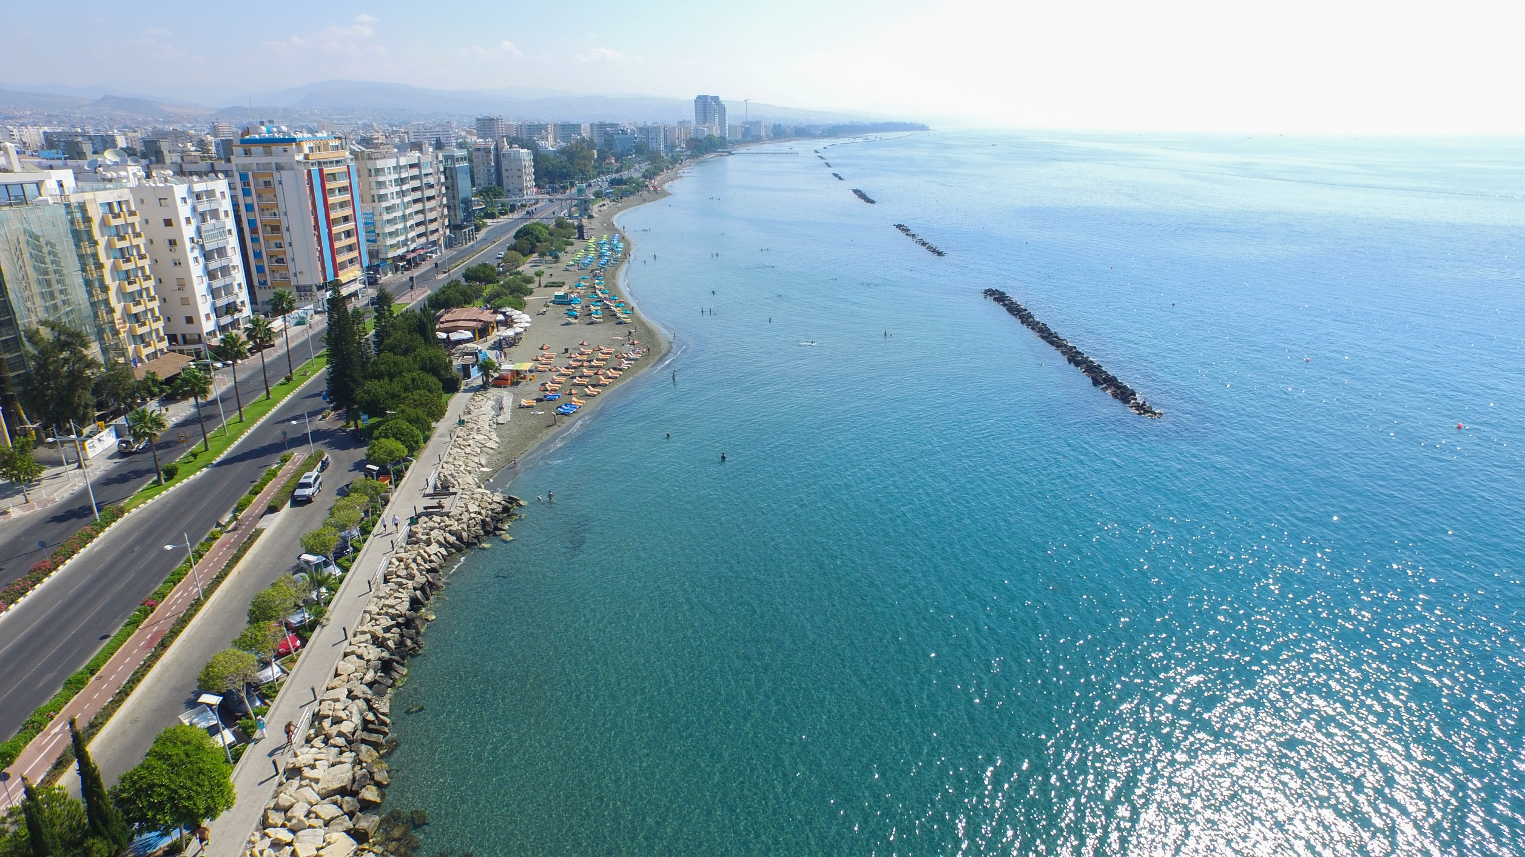
WHY CYPRUS
Established International Business Centre
Strategic Geographic Location
Modern Banking System
Advanced Telecommunications and Infrastructure
High Level of Professional Services
Developed Legal system based on Common Law
and Principles of Equity (easily understood and preferred)
+ Attractive Tax System
Notes:
7

Slide 9
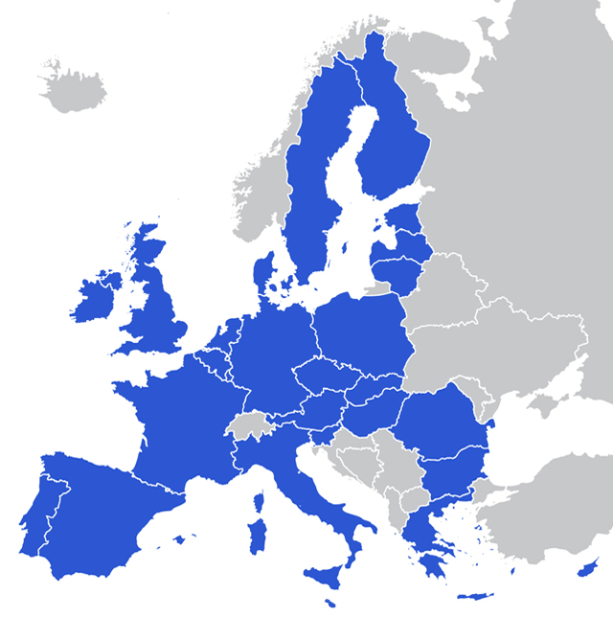
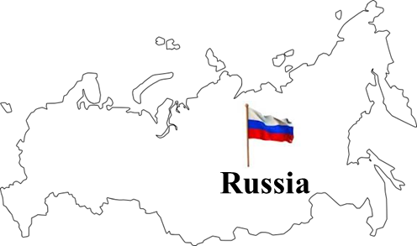
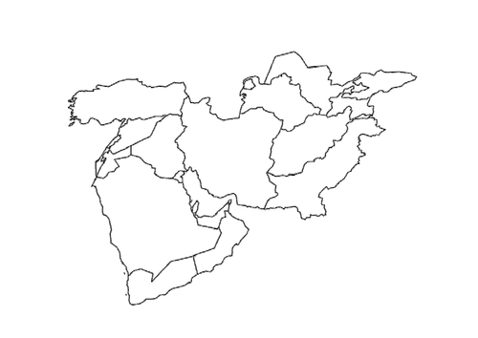
CYPRUS: Gateway to Europe
Increased demand by non-European individuals and companies to have access to Europe …
Middle East
SA

Slide 10
CYPRUS: Base for EU business
Also, increased demand by EU persons and EU businesses who wish to move their personal tax residency and setup HQs and operations in another EU jurisdiction, that also facilitates easy access to certain non-EU markets

Slide 11
Recent tax related incentives
Facilitating SUBSTANCE and MOVE OF KEY PERSONNEL
Relaxing the conditions, criteria and procedure for obtaining Cyprus Naturalisation / Passport.
Introduction of NON-DOMICILE persons within the tax law. This means that foreigners becoming Cyprus tax residents will be completely tax exempt on dividend and interest related incomes from worldwide sources.
Enhancing tax exemption incentives for Cyprus employment income for staff moving to Cyprus;
e.g. 20% annual tax exemption with a maximum exemption amount of eur 8,550 OR 50% annual tax exemption for high earners earning over eur 100,000 per year.
+
Comparative advantages of operating costs on set up and maintenance of offices (when compared to other EU jurisdictions)

Slide 12
Non-Domiciled (Non-Dom)
Cyprus Tax Resident if physically spends MORE than 183 days in Cyprus
Who is a NON-DOM?
Was NOT a tax resident in Cyprus for 17 out of the previous 20 years; AND
Does NOT have a Cypriot domicile of origin
(Domicile of origin is received at birth)
It may also apply to people with Cypriot domicile of origin under specific circumstances.
Subject to Cyprus taxes on worldwide income
MAIN APPLICABLE TAXES Income Tax (e.g. on salary, rents etc) Note: first eur 19,500 tax exempt | Band rates 20% - 35%
Special Defence Contribution (SDC)
- On rents | 2,25%
- On dividends | 17%
- On bank deposit interest | 30%
Note: Dividends and Interest are exempt from income tax and are taxed only under defence tax.
Profit from sale of shares Capital Gains Tax on Cyprus immovable property | Exempt 20%
→ Not via application but it is AUTOMATIC
Benefit of a Non-Dom?
EXEMPTION FROM SDC
But this is VERY important for HNWI’s as their main source of income comes from dividends, interest, capital gains as well as distributions from Trusts.
… incomes which are automatically tax exempt for non-doms.

Slide 13
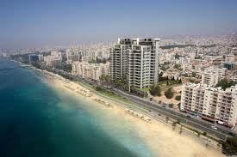
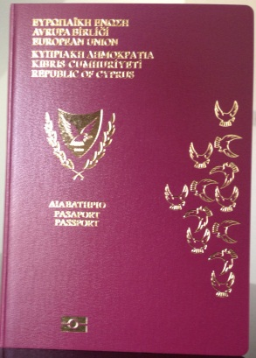
Cyprus relocation schemes for non-Europeans
Temporary Work and Residence permit
» Issued for 1-5 years if employed by a Cyprus company. Renewable if needed.
Permanent Residence Permit (“PRP”)
New accelerated procedure (granted within two months)
» Main requirements include acquiring a property in Cyprus of at least €300.000, a fixed three year deposit in a Cyprus bank for €30.000 and have secured annual income of €30.000 from activities outside of Cyprus.
Certificate of Naturalization / Citizenship = Cyprus (EU) Passport
Eligibility criteria have recently been relaxed and made more flexible
» Main requirements include acquiring a property in Cyprus of at least €500.000 AND
effecting any pre-approved type of investment of at least €2m (investment to be kept for a minimum of 3 years). There is no element of donation whatsoever.

Slide 14
Thank You!
Andry Panteli, FCCA
Director
andry.panteli@pgeconomides.eu
P.G.Economides & Co Ltd
Chartered Certified Accountants
www.pgeconomides.eu

